Slide 1






Project Title:
Problem Statement: Automated Footprint Analysis
Project Sponsor : Apollo R&D
Project Owner : Unnikrishnan P K
Industry Mentor : Mr. HariGovindan
Faculty Mentor : Dr. Suchithra. M
Students : Vishal Khumar PD
Ayushi Gupta
Niloy Nath
Arnav SIngh
Technical Values: Length, Width, Net Area, Gross Area, Land Ratio
Key Inventive step/Uniqueness of solution: Color Segmentation, Contour Detection, Size and Aspect Ratio Filtering, Polygon Approximation, Geometric Analysis*
Project Start Date : Dec’23
Project SoP : May’24
Project Deliverable with AQL(Acceptable Quality Levels): The code delivers accurate measurements for the footprints and accurate image colour levels. The AQL can be 0.6% for every 100 images.
Milestone 1
Measurement of overall dimensions
Milestone 2
Milestone 3
Measurement of feature-wise pressure, area, and force
Milestone 4
Validation and final deployment
Separation of features and measurement of feature dimensions
Plan
Date: Dec’23
Date: Jan’24
Date: Feb’24
Date: Mar’24
Actual
Date: Jan’24
Date: Jan’24
Date: Mar’24
Date: May’24

Slide 2



Project Title:
Process Schema
Input
Tyre Footprint Dataset
Process (What is differentiator from current)
Integrated the parts of code individually as well as together to create a friendly user interface. This will help in a smooth onboarding,
Output
Segregating pressure contact area
boundaries
length, width and net area, land ratio
Stack graphs for column-wise and row-wise
Key Risks and Challenges
Maintaining confidentiality of footprint data set and getting desired output for the input images as all the photos belonged to different tyres.
Obtaining the expected outcome in the construction of stack graphs proved to be the biggest challenge as there were areas in the images that were unnecessary but were still visible in the graph.
Sorting out the stack graph was another issue faced as all the colours were supposed to be plotted together which required regressive code optimization.
Mitigation Plan
To ensure the confidentiality of the footprint dataset and achieve accurate outputs for tire images, we created a private repository on GitHub to securely upload and manage all data
To mitigate unnecessary areas in the stack graphs, refine contour filtering criteria, improve mask creation and combination, and apply morphological operations (like opening and closing) to remove small noise from the masks. This will ensure only relevant regions are analyzed.
Enhanced contour filtering, mask creation, and algorithm efficiency to resolve stack graph issues, ensuring seamless color plotting and grouping.

Slide 3
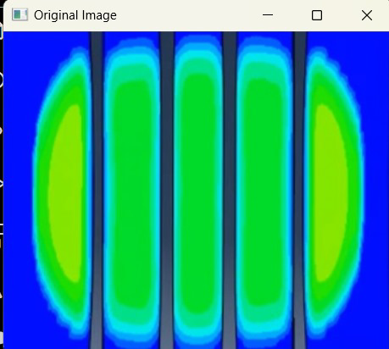
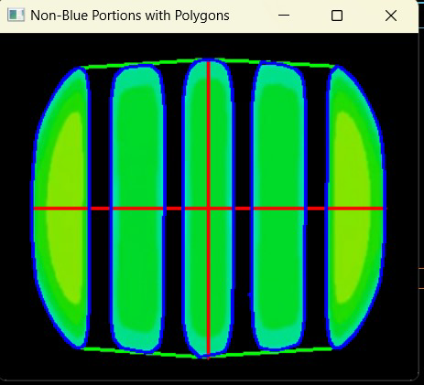
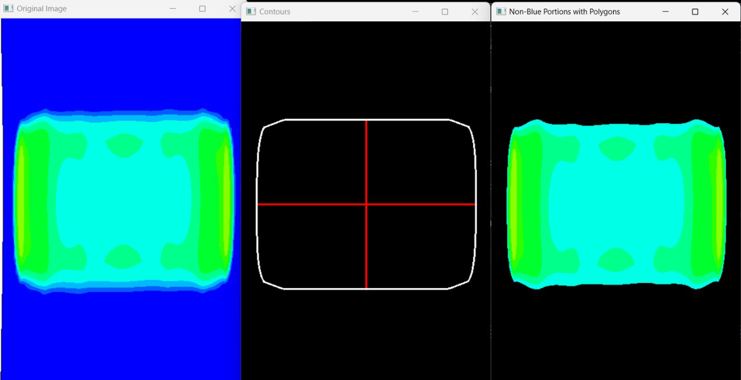
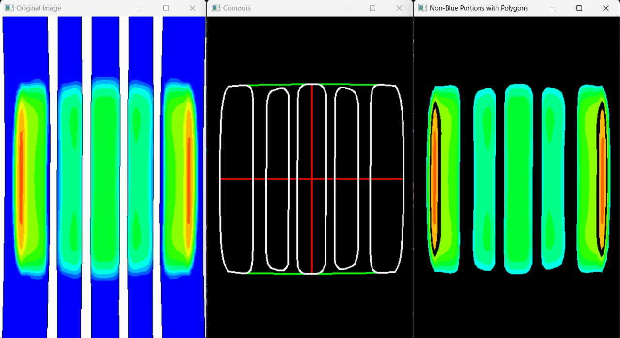
Milestone 1: Measurement of overall dimensions

Slide 4
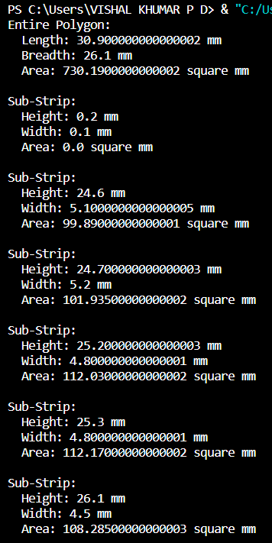
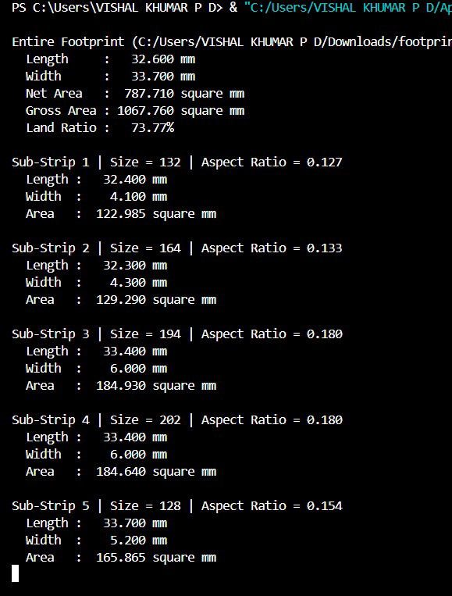
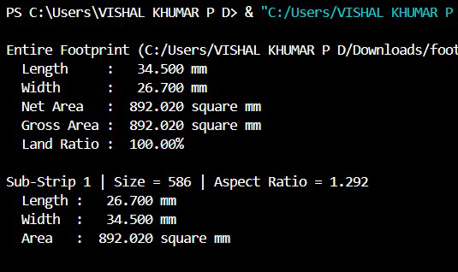
Milestone 2 and 3: Separation of features and measurement of feature dimensions

Slide 5
Milestone 2 and 3:

Slide 6
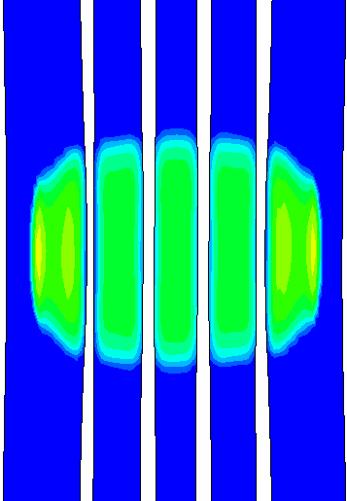
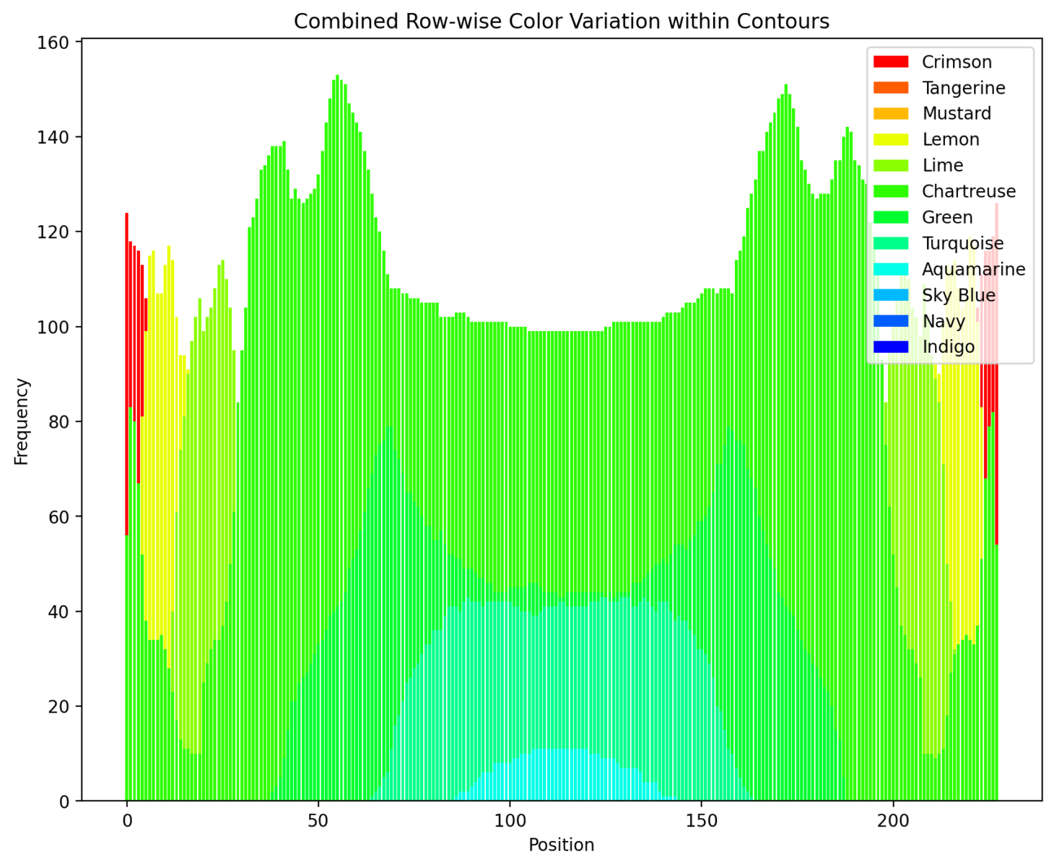
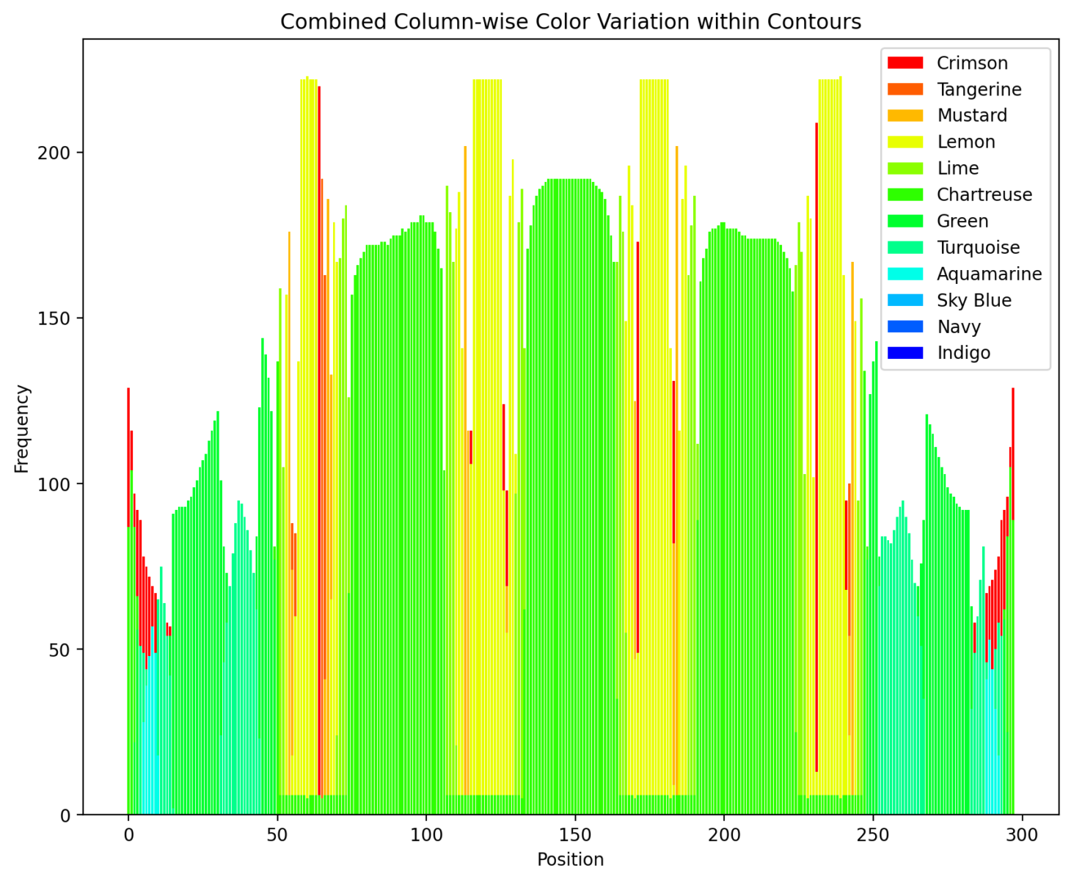
Milestone 4: Validation and Final Deployment (Column-wise and Row-wise Graphs)

Slide 7
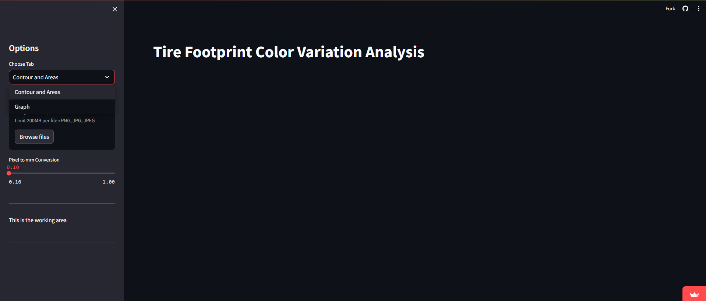
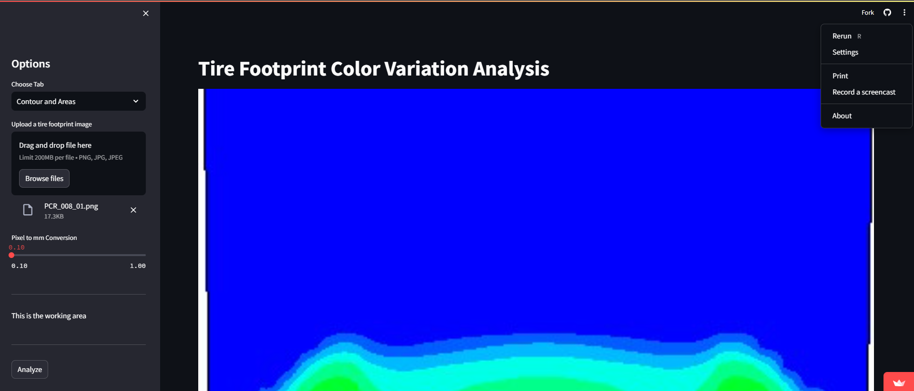
Milestone 4: Validation and Final Deployment (Streamline Interface and Interface generated Documentation)

Slide 8
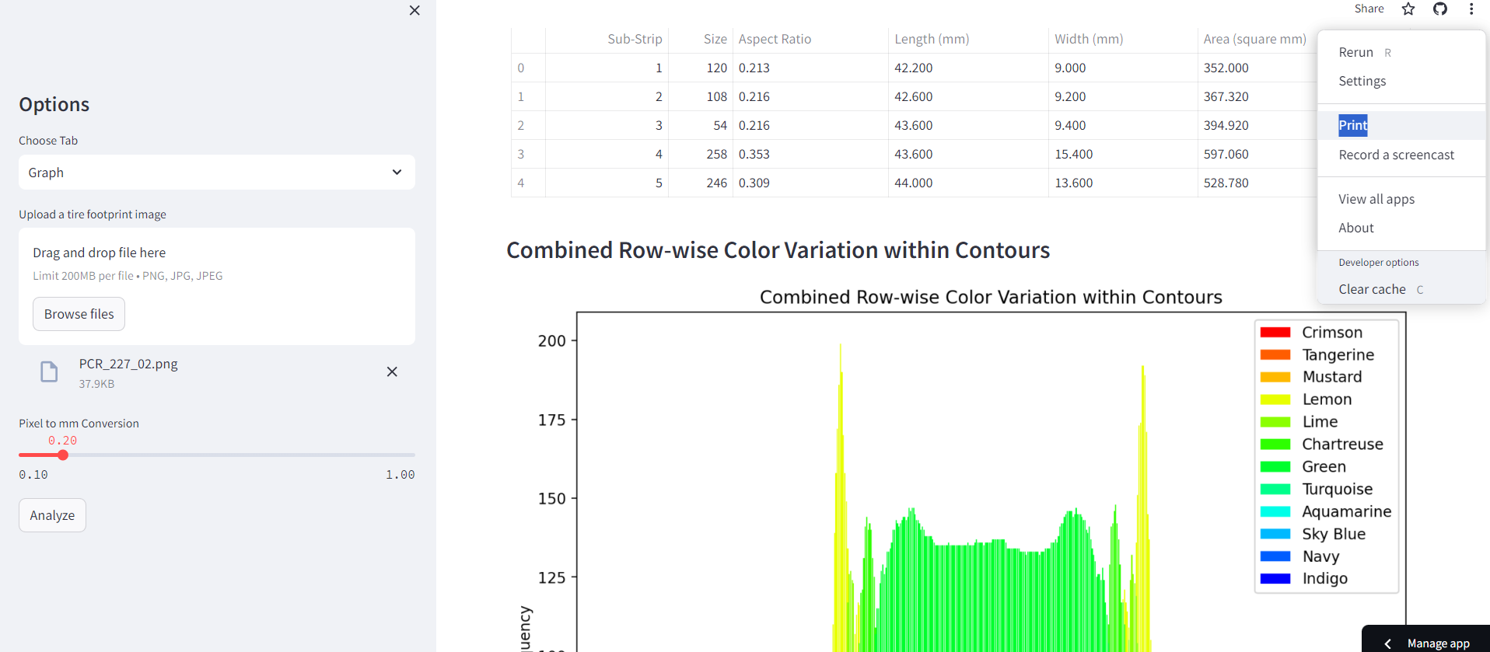
REPORT GENERATION

